Slide 1


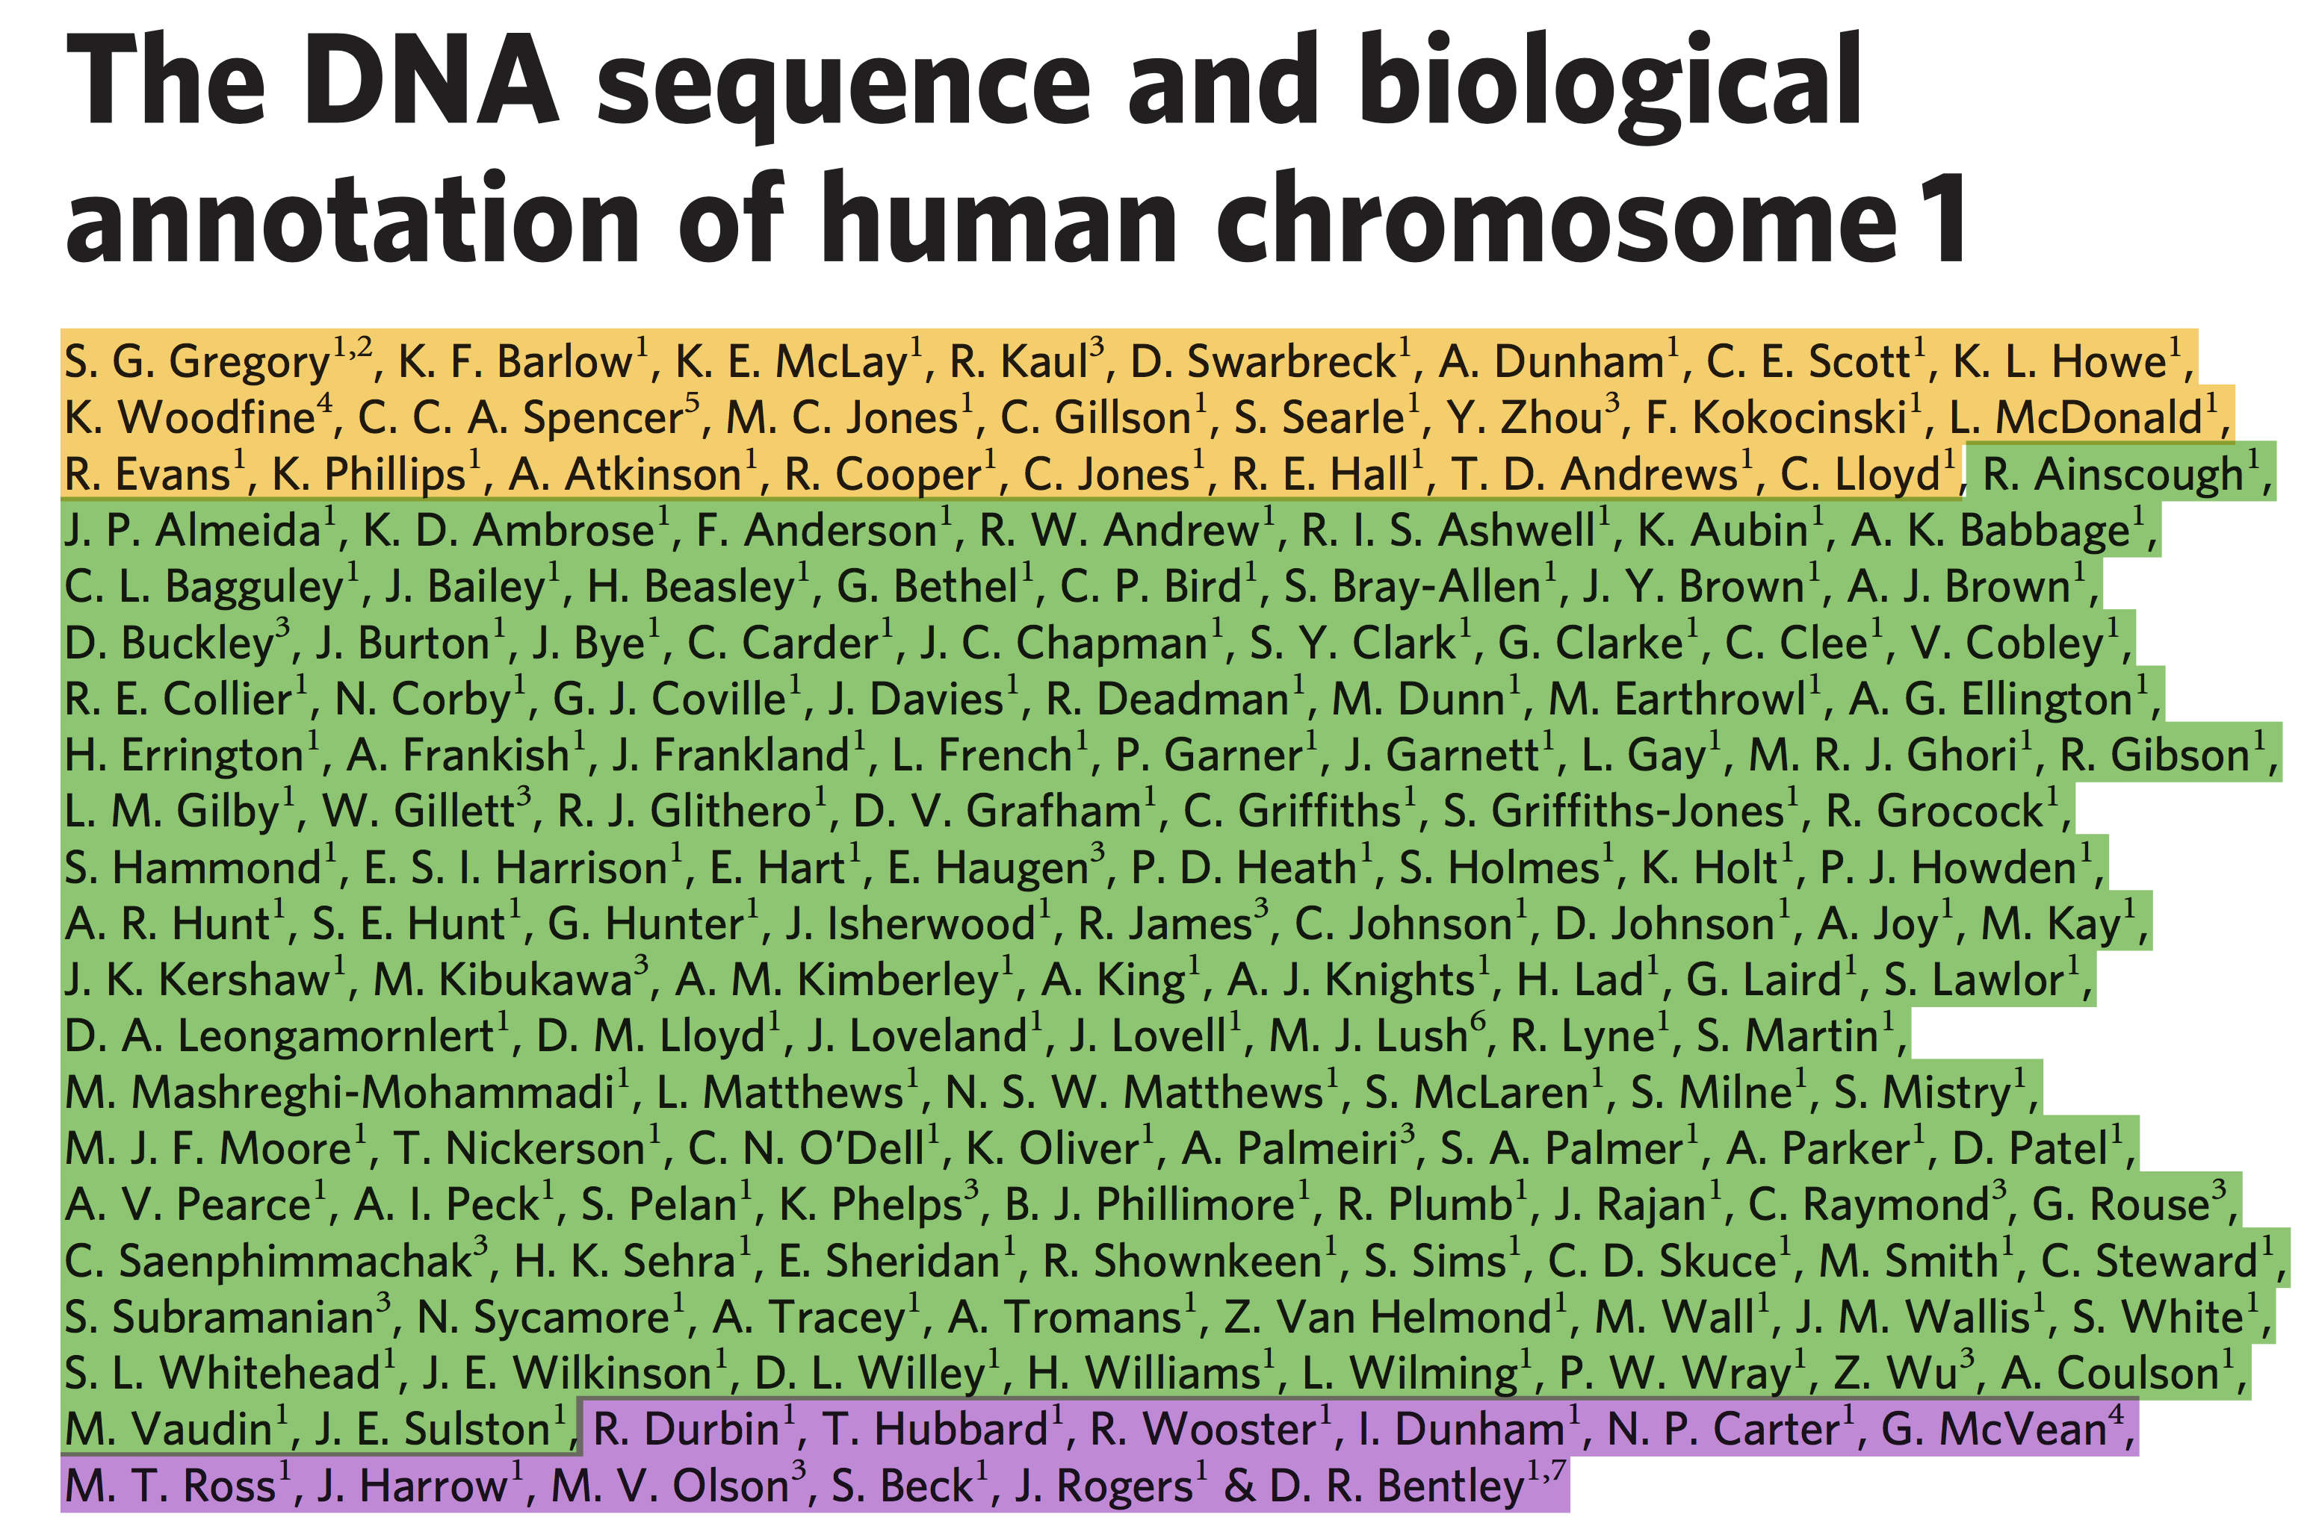
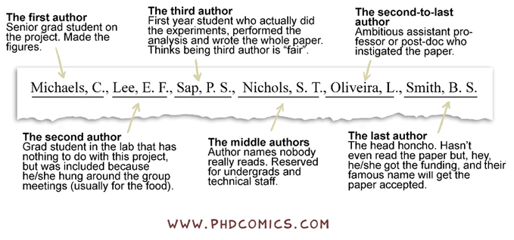
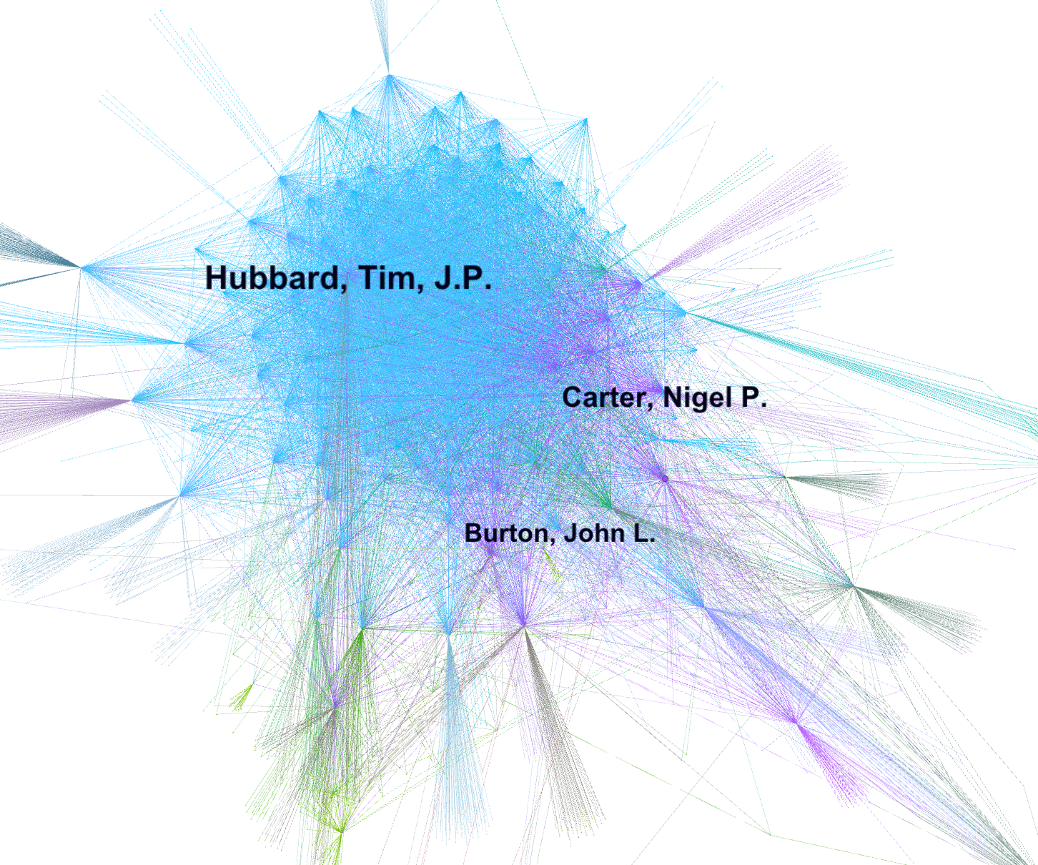
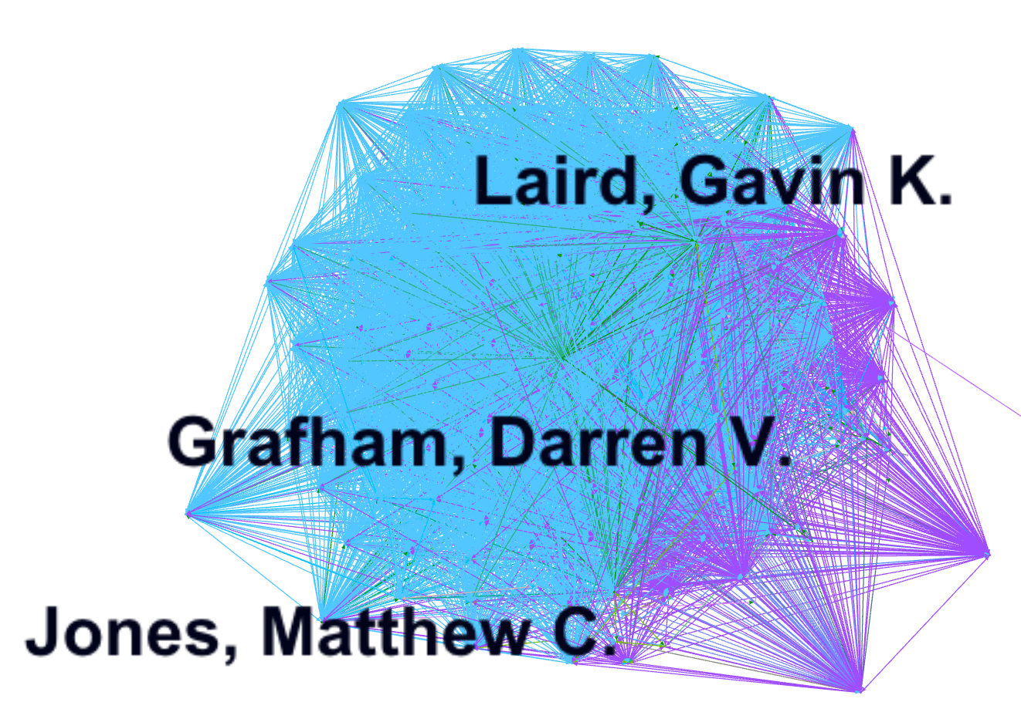
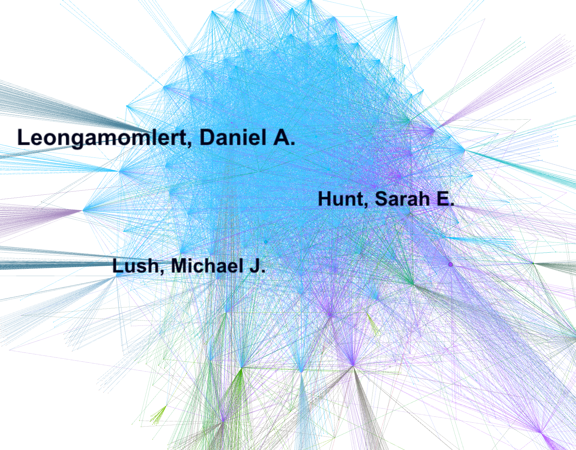
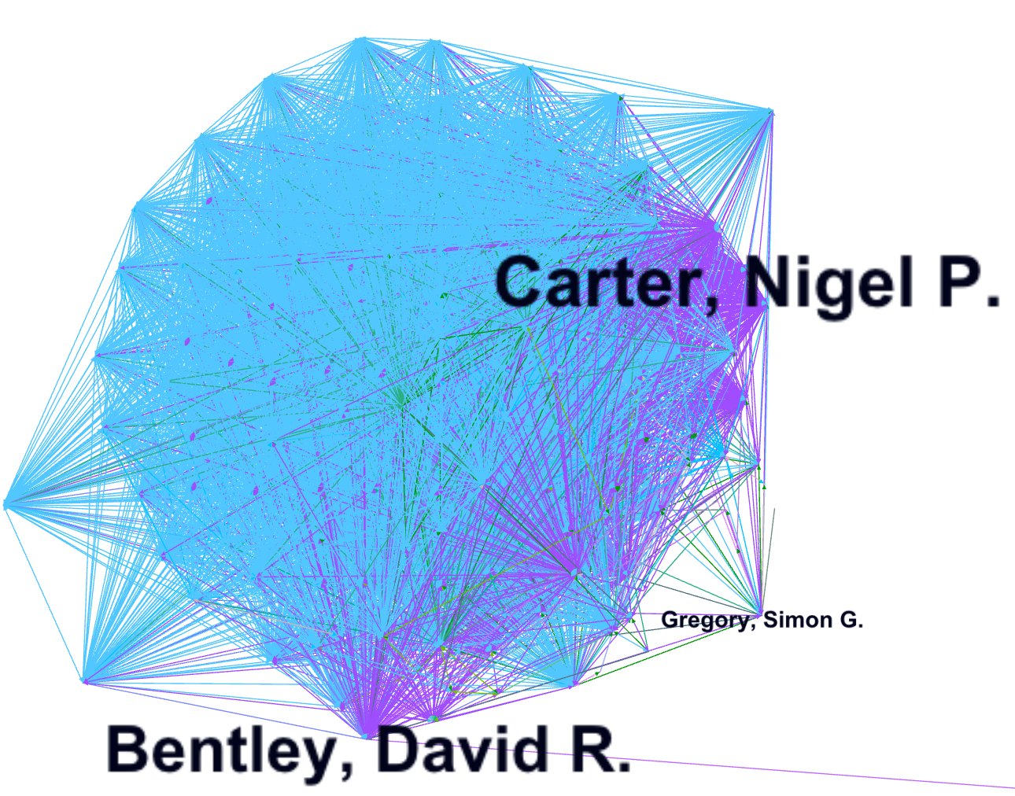
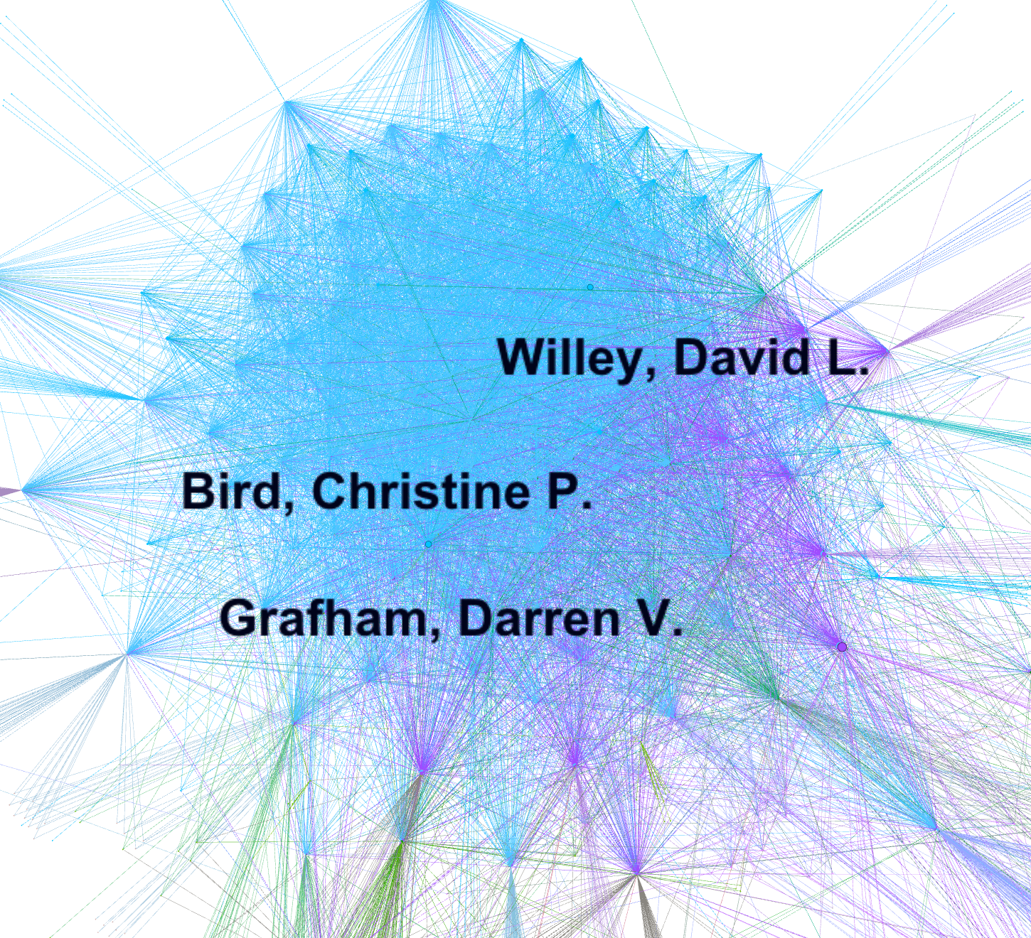
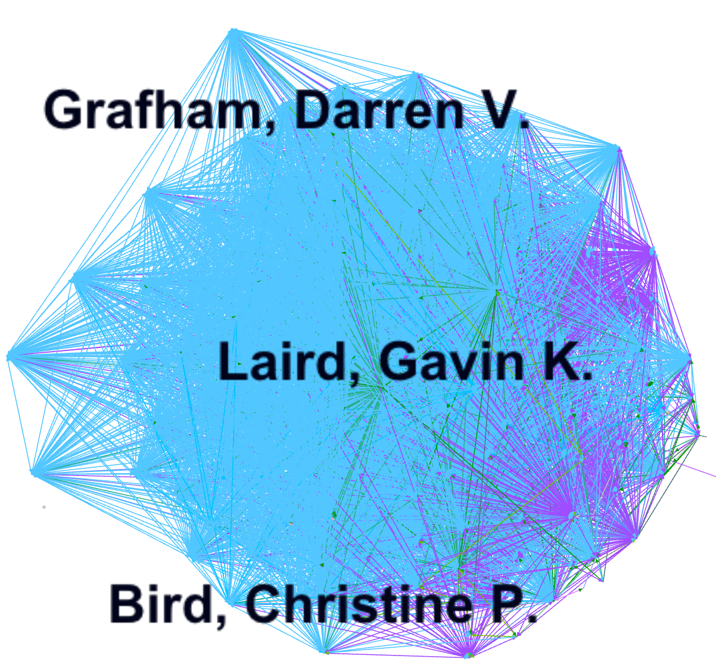

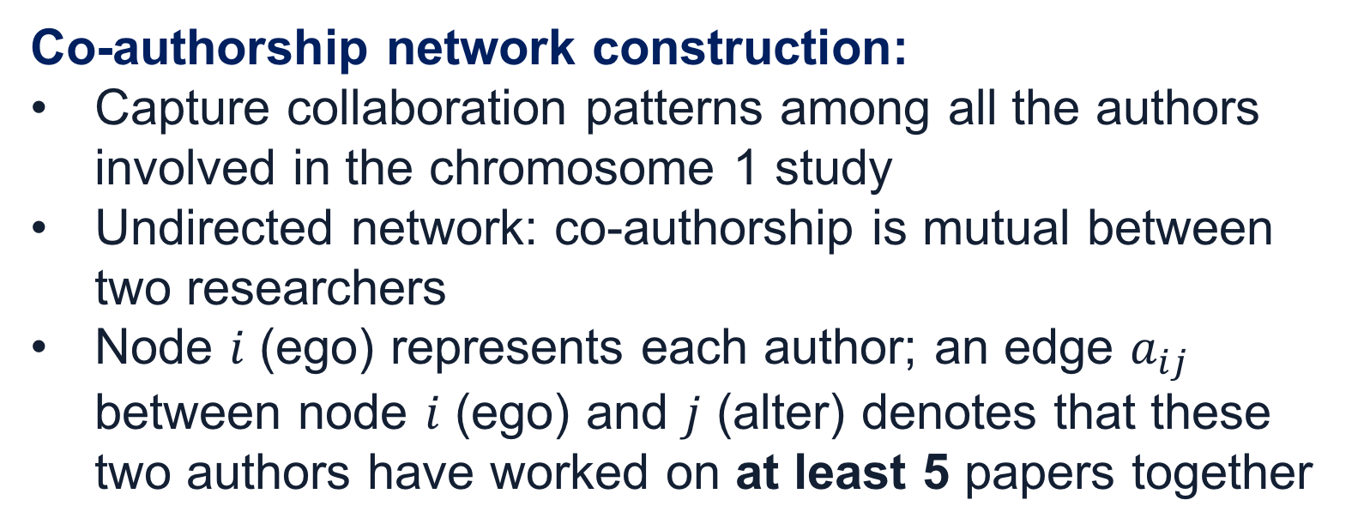
Middle of the (by)line: Examining hyperauthorship networks in the Human Genome Project
Ly Dinh, Yi-Yun Cheng School of Information Sciences, University of Illinois at Urbana-Champaign
hyperauthorship ; co-authorship networks; author byline
INTRODUCTION
Large-scale scientific endeavors are on the rise:
e.g. Human Genome Project (HGP), CERN Large Hadron Collider
Number of authors associated with these research projects substantially increase as well
Co-authorship dynamics has evolved:
BEFORE: multiple authors (2~6 authors per paper)
NOW: ‘mega-’ , ‘hyper-’ authors (80~200 authors)
Hyper-authored research:
More of a convention in scientific domains such as biology, high energy physics, and medicine
Requires large and complex coordination of tasks
Author-ordering tradition in genomics (e.g. chromosome sequencing tasks):
Usually listed authors in three parts: first, middle, last
Group 1 First authors: main contributors
Group 2 Middle authors: data collections, annotation → assumed to make smaller contributions
Group 3 Last authors: senior researchers supervising the research
METHOD
CONCLUSION
HGP is a leading example of big science that requires collaborative efforts from hundreds to thousands of researchers who are from a wide range of disciplines
CREDIT WHERE CREDIT IS DUE
Determining where credit is due remains a conundrum in a hyper-authored setting
Middle authors hold essential positions within the collaboration network in the chromosome 1 research
Misallocation of credits may result in misallocation of funding opportunities and academic positions
→ OUR VIEW: Providing a contribution list to describe whodunwhat in conjunction with the author byline is a necessary practice
Future work:
Examining in detail the collaboration dynamics among the first, middle, and last authors of ALL published works by a number of research centers affiliated with the HGP
A post-hoc analysis reveals that the topology of this network exhibits more desired properties of a small world network, rather than a scale-free network as with most co-authorship networks (Barabasi & Albert, 1999). We will also examine this finding in further details.
Data collection:
Co-authorship data on articles published by the Sanger institute on the results of sequencing 8 chromosomes: 1, 6, 9, 10, 13, 20, 22, and X
The 8 papers identified were published between the years of 1999 to 2006, and were all highly-cited within the field
Focus of this study: published work on chromosome 1, the largest human chromosome, thus requiring the most coordinated efforts to annotate and sequence
Unit of analysis:
Chromosome 1 paper (Gregory et al, 2006)
166 authors: 24 are first authors, 127 are middle authors, and 15 are last authors (Figure 1)
Data on authors’ affiliations, general demographics as well as the list of co-authors are obtained from the ISI Web of Science and Scopus
Tools used:
R’s igraph package: constructing the network matrix and calculating network measures
Gephi: visualizing the whole network and the induced subgraphs
Figure 1. Three-parts author structure of the chromosome 1 paper
Co-authorship network construction:
Capture collaboration patterns among all the authors involved in the chromosome 1 study
Undirected network: co-authorship is mutual between two researchers
Node $i$ (ego) represents each author; an edge $a_{ij}$ between node $i$ (ego) and $j$ (alter) denotes that these two authors have worked on at least 5 papers together
RESULTS
Table 1 exhibits the network characteristics of both the whole network and the induced network
The whole network:
includes ego-alter relationships and alter-alter relationships (co-authors tied to the focal author are also tied to each other)
Density is low (ρ=0.008) (mean degree of 14.69 edges per author); Clustering coefficient is high at (C=0.843); Average path length is low (𝓁= 3.538)
→ Middle authors (Group 2) score high in Betweenness and Eigenvector centralities
The induced network:
subset of the whole network with specified egos and alters who are 166 authors in the chromosome 1 paper
Density is much higher (ρ=.705) (mean degree of 116 edges per author); Clustering coefficient is very high at (C=0.908); Average path length is minimal (𝓁= 1.425)
→ Middle authors (Group 2) score high in Degree and Eigenvector centralities
REFERENCES
Birnholtz, J. P. (2006). What does it mean to be an author? The intersection of credit, contribution, and collaboration in science. Journal of the Association for Information Science and Technology, 57(13), 1758-1770.
Cronin, B. (2001). Hyperauthorship: A postmodern perversion or evidence of a structural shift in scholarly communication practices?. Journal of the Association for Information Science and Technology, 52(7), 558-569.
Gregory, S. G., Barlow, K. F., McLay, K. E., Kaul, R., Swarbreck, D., Dunham, A., ... & Jones, M. C. (2006). The DNA sequence and biological annotation of human chromosome 1. Nature, 441(7091), 315.
Ioannidis, J. P. (2008). Measuring co-authorship and networking-adjusted scientific impact. PLoS One, 3(7).
Mongeon, P., Smith, E., Joyal, B., & Larivière, V. (2017). The rise of the middle author: Investigating collaboration and division of labor in biomedical research using partial alphabetical authorship. PloS one, 12(9).
AIM
RQ: Investigate the hyperauthorship phenomenon of one major research publication from the Wellcome Trust Sanger Institute (biggest contributors to sequencing human chromosomes)
Using co-authorship network analysis to:
Examine the collaboration dynamics in HGP
Extrapolate the three-parts structure of partial author byline (some authors are listed alphabetically, some not)
Whole- Degree centrality
Induced- Degree centrality
Name | Group
1.Hubbard, Tim J. P. | 3
2.Carter, Nigel P. | 3
3.Burton, John L. | 2
Name | Group
1.Grafham, Darren V. | 2
2.Laird, Gavin K. | 2
3.Jones, Matthew C. | 1
ACKNOWLEDGEMENTS
The authors thank the Goggin fund and the Smith fund from U of I School of Information Sciences for the generous travel support. The authors also thank Dr. Jana Diesner and Dr. Bertram Ludäscher for their kind feedbacks.
Whole- Betweenness centrality
Induced- Betweenness centrality
Table 1. Overview of network characteristics
Name | Group
1.Leongamornlert, Daniel A. | 2
2.Hunt, Sarah E. | 2
3.Lush, Michael J. | 2
Name | Group
1.Bentley, David R. | 3
2.Carter, Nigel P. | 3
3.Gregory, Simon G. | 1
Measures | Whole network | Induced network
Number of nodes | 1918 | 166
Number of edges | 14,088 | 9,653
Density | 0.008 | 0.705
Degree centralization | 14.69 | 116
Betweenness centrality | 2,213 | 21.63
Eigenvector centrality | 0.055 | 0.557
Clustering | 0.843 | 0.908
Average path length | 3.538 | 1.425
CONTACTS
{dinh4, yiyunyc2}@illinois.edu
https://github.com/yiyunyc2/ASIST18
Whole- Eigenvector centrality
Induced- Eigenvector centrality
Name | Group
1.Grafham, Darren V. | 2
2.Willey, David L. | 2
3.Bird, Christine P. | 2
Name | Group
1.Grafham, Darren V. | 2
2.Laird, Gavin K. | 2
3.Bird, Christine P. | 2

